Slide 1





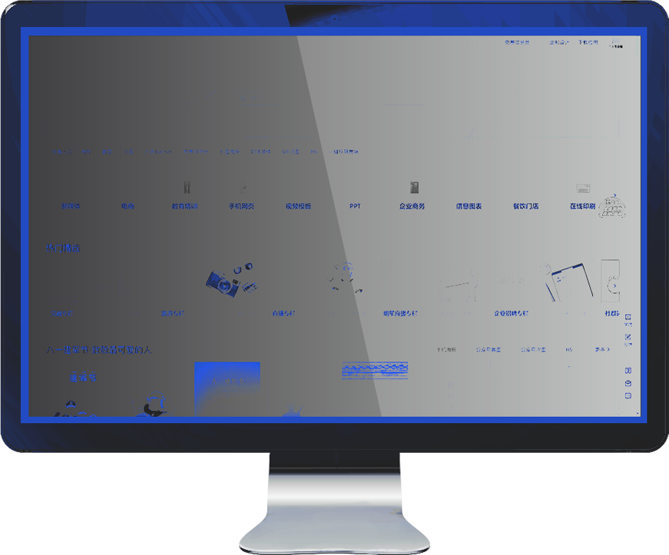

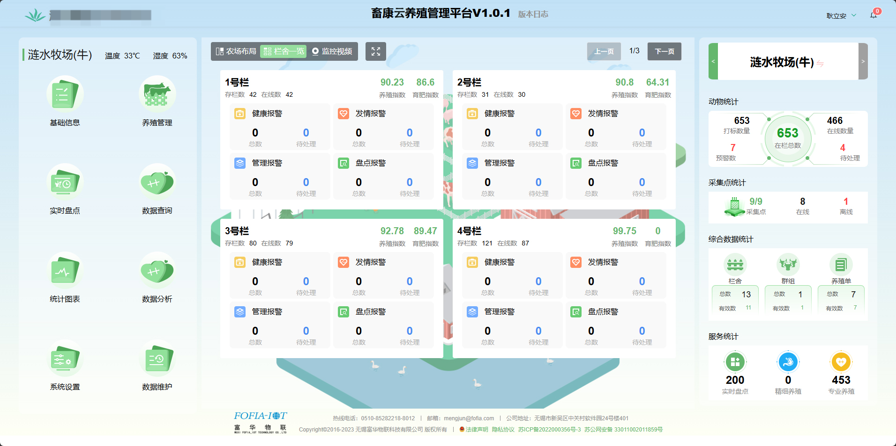
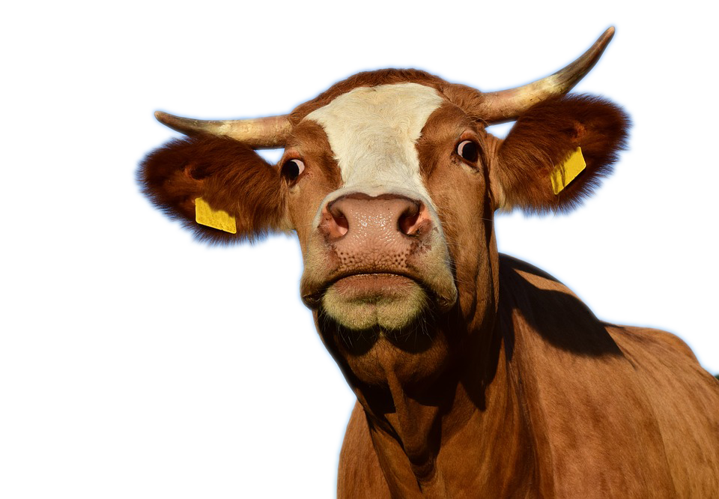
无锡富华物联科技有限公司
Wuxi Fofia IoT Technology Co.,Ltd
畜康云PC-side
Cattle in/out operations
（create pens/barns, create farming batches, enter animal records, animal entry, animal exit, and add roles and permissions）

Slide 2




目录
DIRECTORY
01
02
03
Logo in PC
Create pens/barns
Create farming batches
&
enter ear tag numbers
04
05
06
Modify and add roles, manage permissions
Stock in
Stock out

Slide 3


01
LOGO IN PC

Slide 4

LOGO IN PC
Log in to https://iot.realid315.com/, then click Personal Center

Slide 5
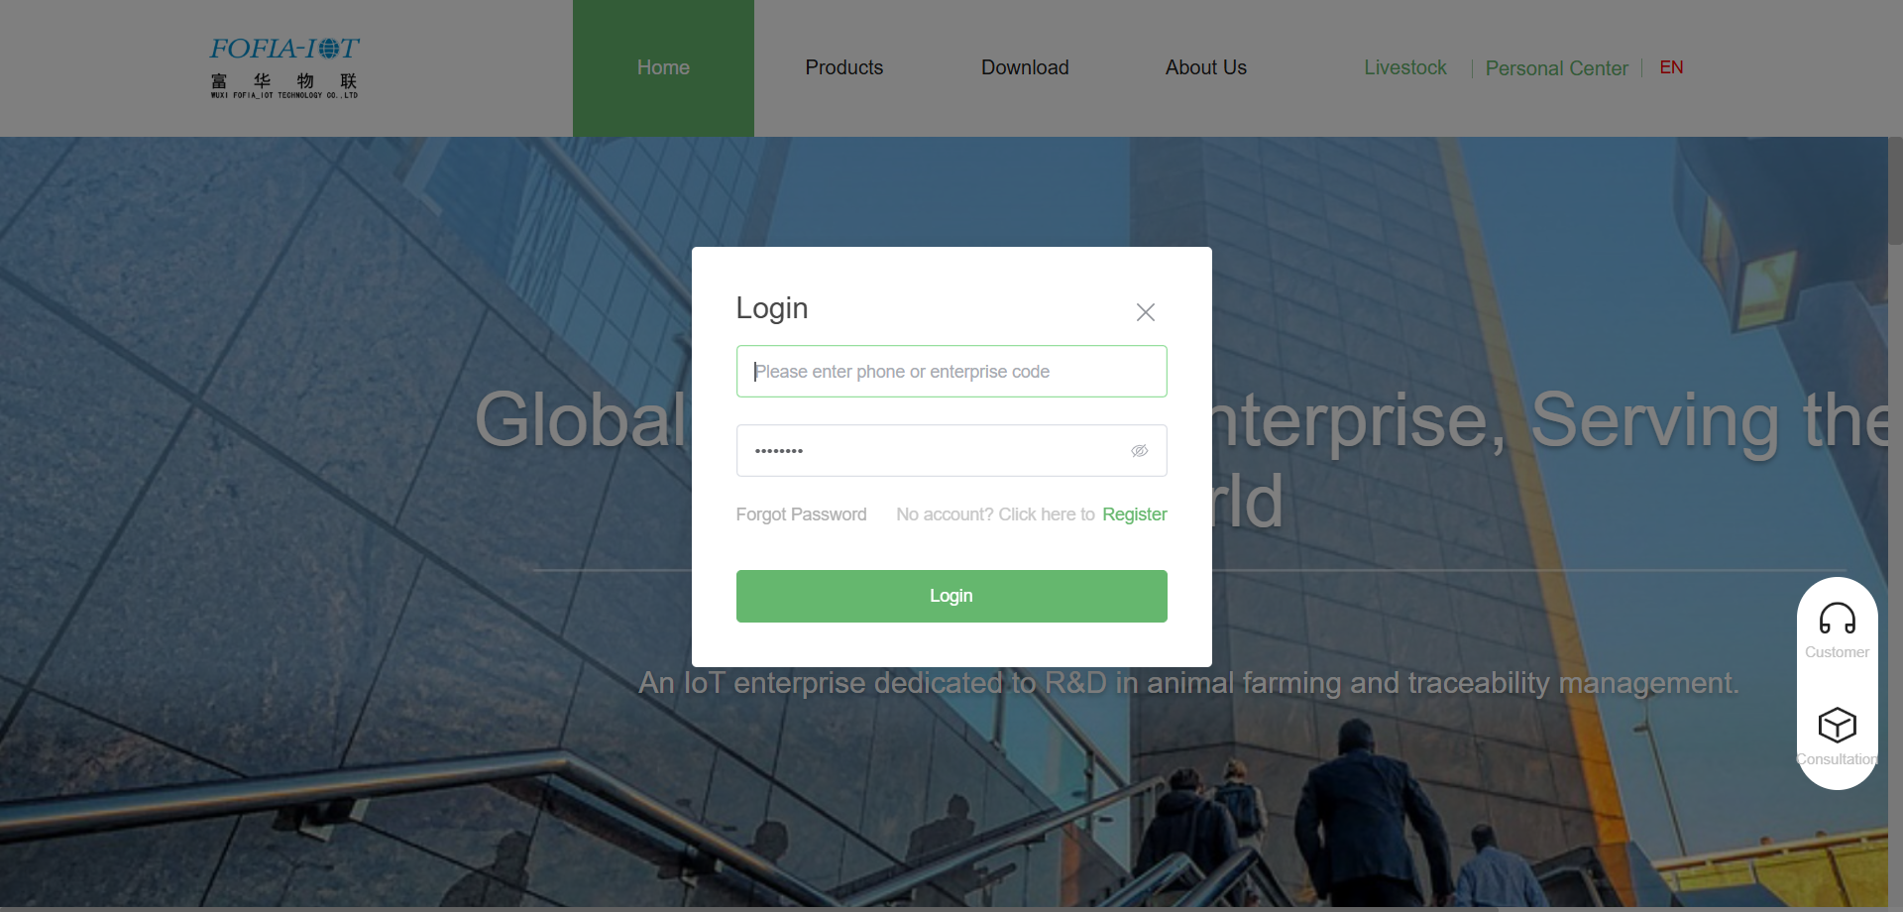
LOGO IN PC
Enter account and password, then click Login

Slide 6

LOGO IN PC
Click the Livestock System button

Slide 7
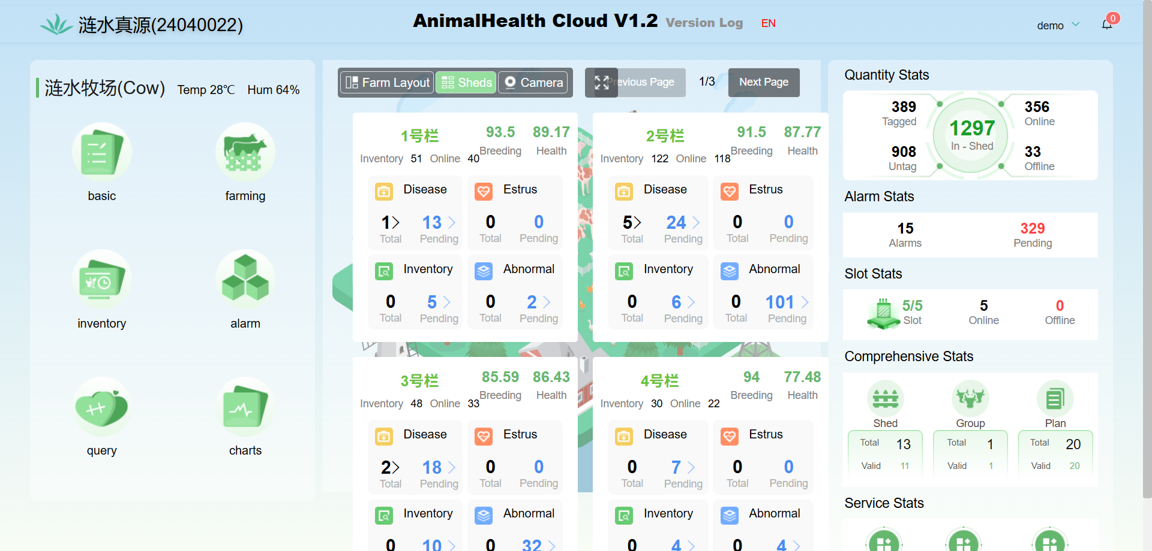
LOGO IN PC
You can now access PC

Slide 8
02
Create pens/barns

Slide 9
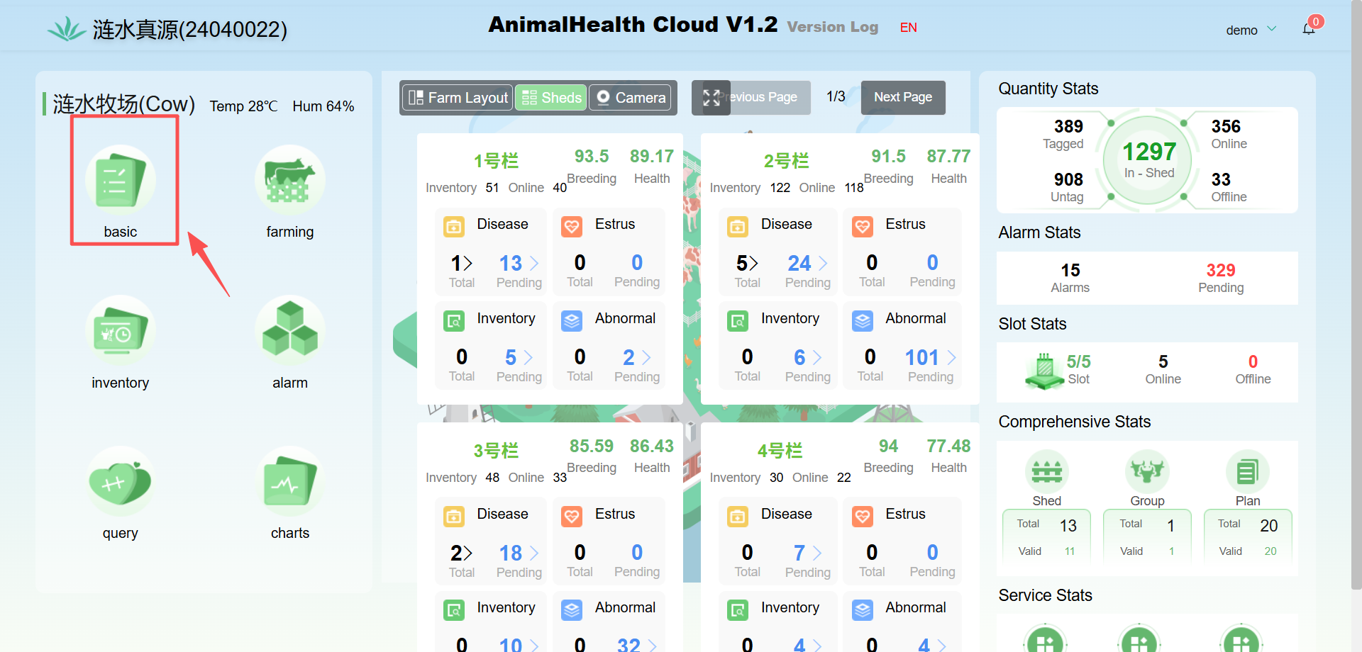
create pens/barns
Click Home → Basic Information

Slide 10
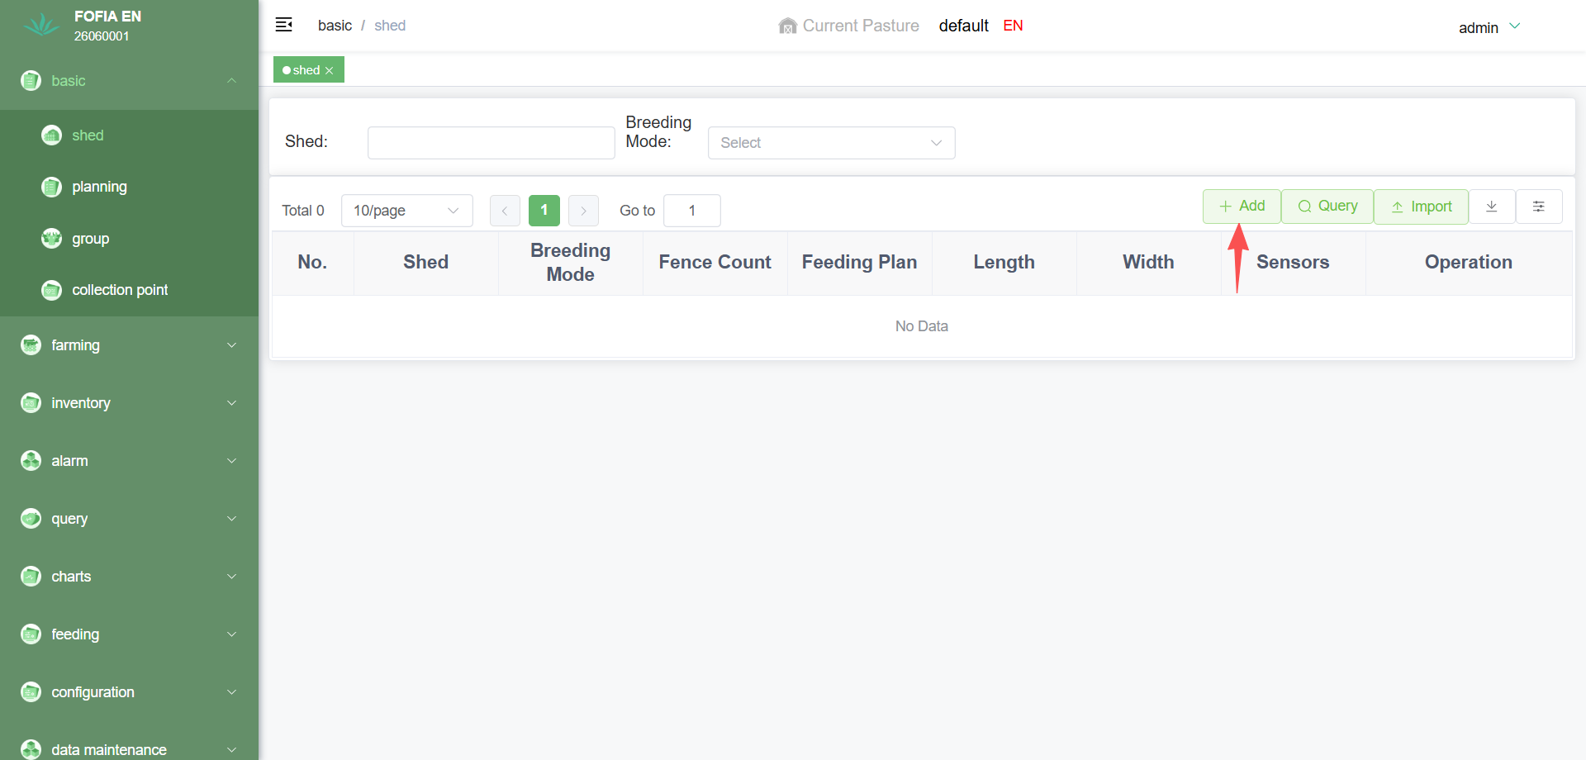
create pens/barns
Click Pen Management → Add New

Slide 11
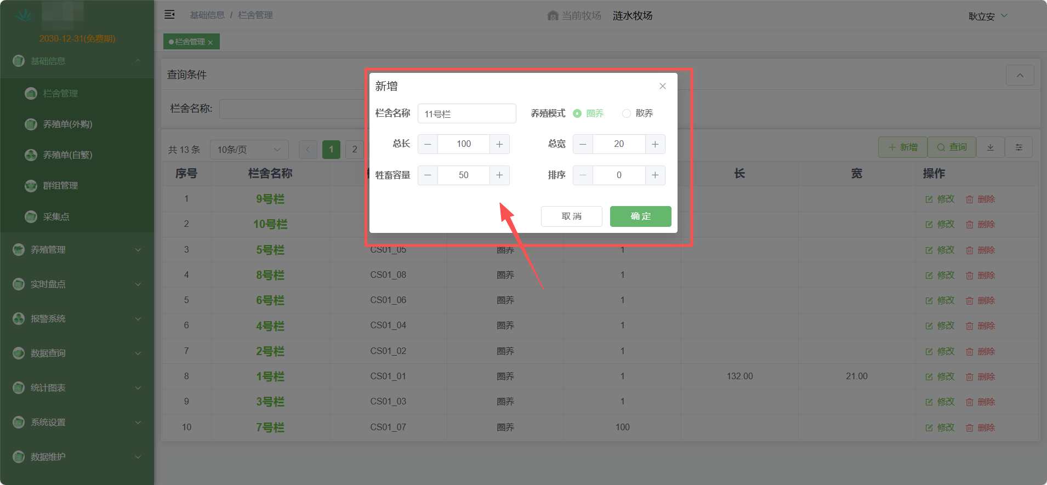
create pens/barns
Enter pen information and add the pen

Slide 12
03
Create farming batches and enter ear tag numbers

Slide 13
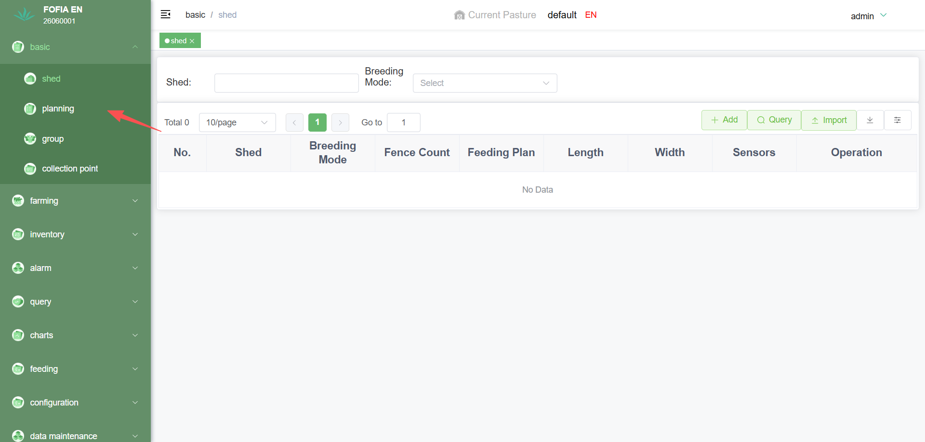
Create farming batches and enter numbers
Click Basic Information on the left → Farming Batch

Slide 14
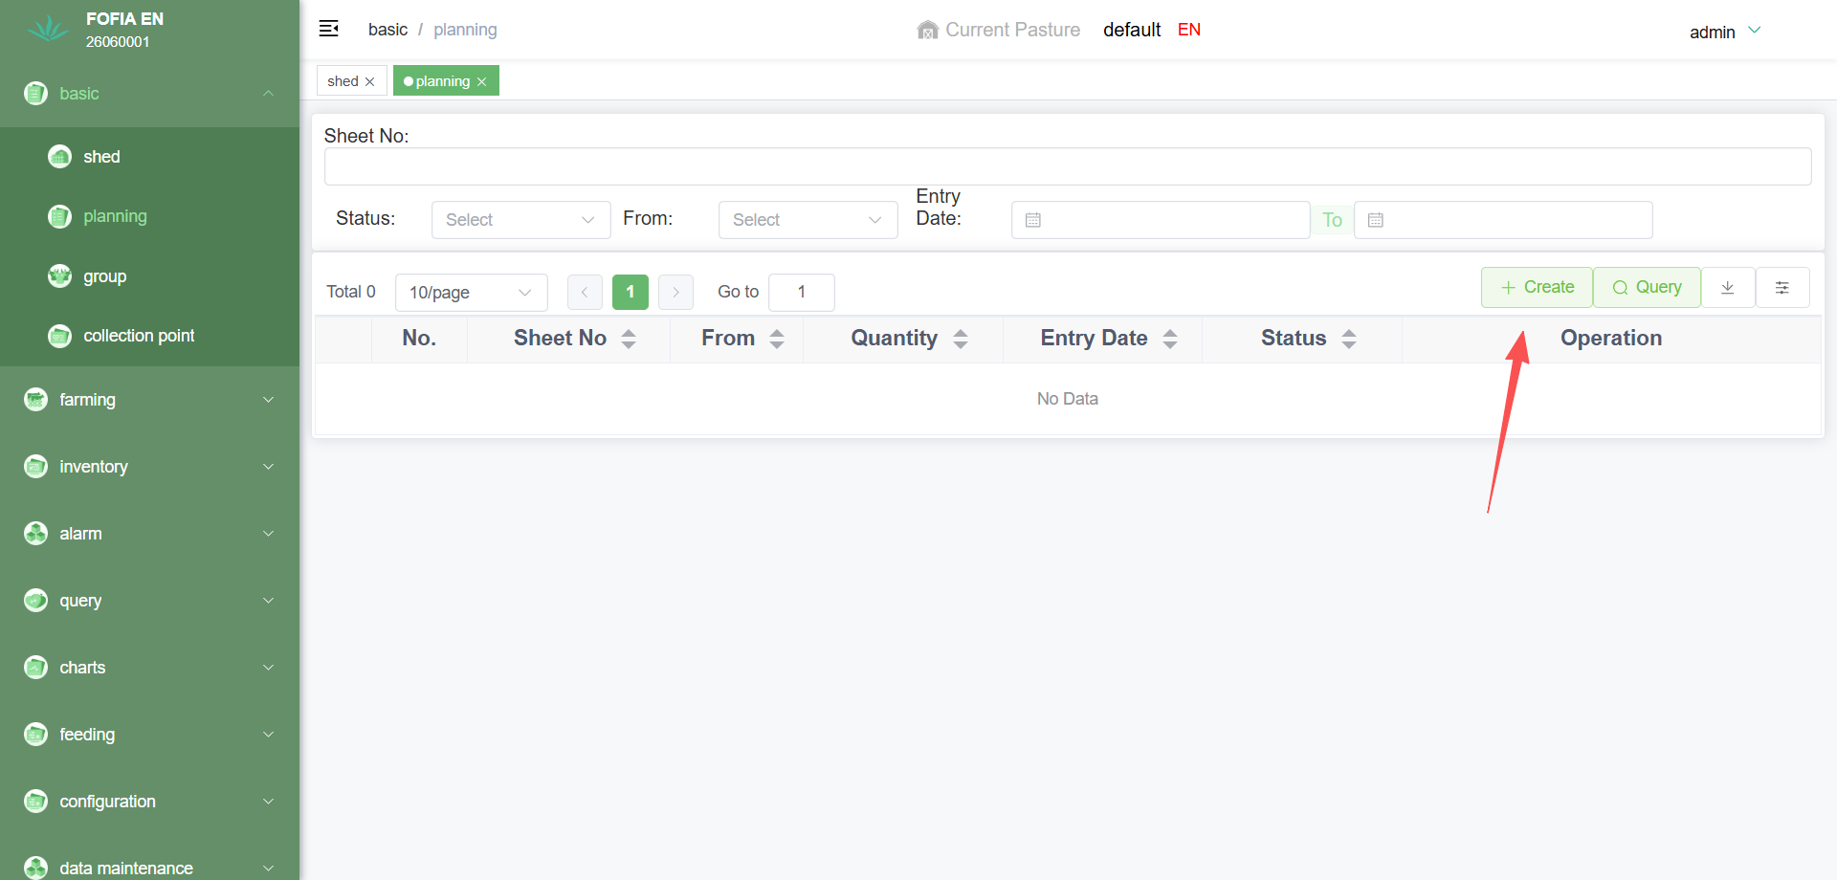
Create farming batches and enter numbers
Click the Create button on the right to create a batch

Slide 15
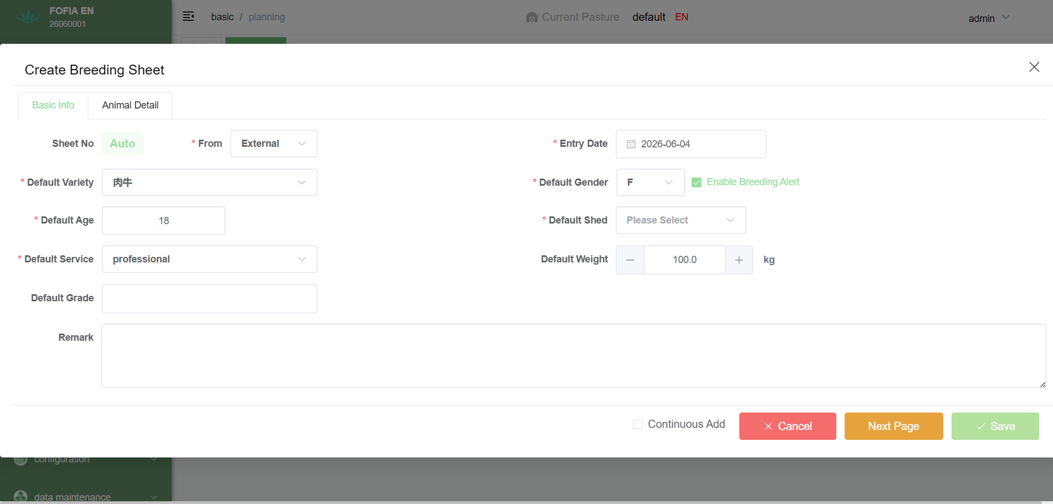
Create farming batches and enter numbers
Fill in the basic information of the batch, then click Next

Slide 16
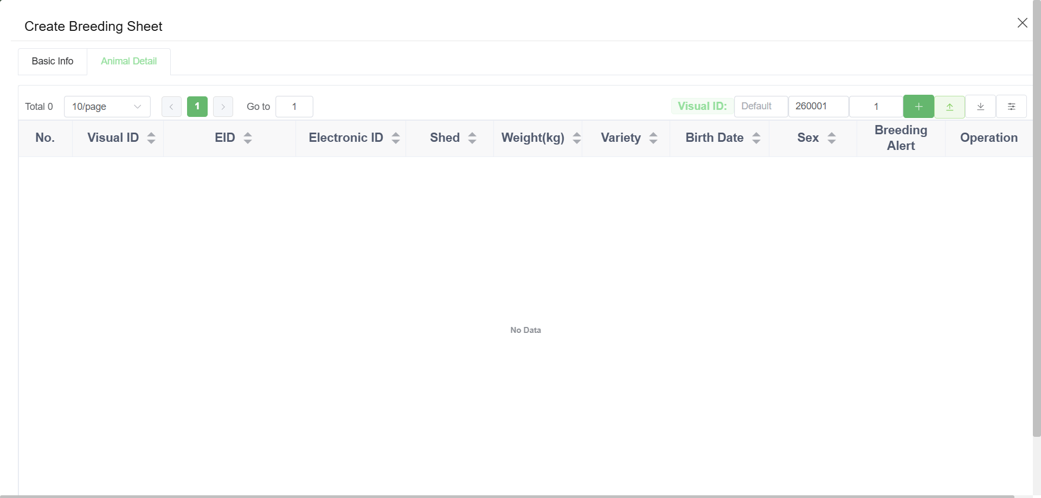
Create farming batches and enter numbers
Click Export to EXCEL

Slide 17
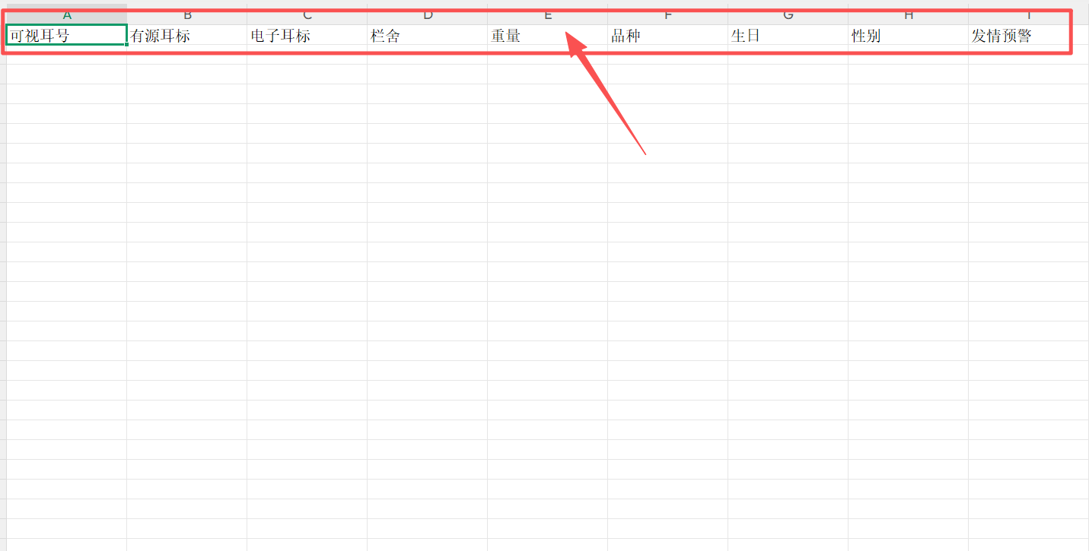
Create farming batches and enter numbers
Enter animal visual ear tags, active ear tags, and other information in the EXCEL file

Slide 18
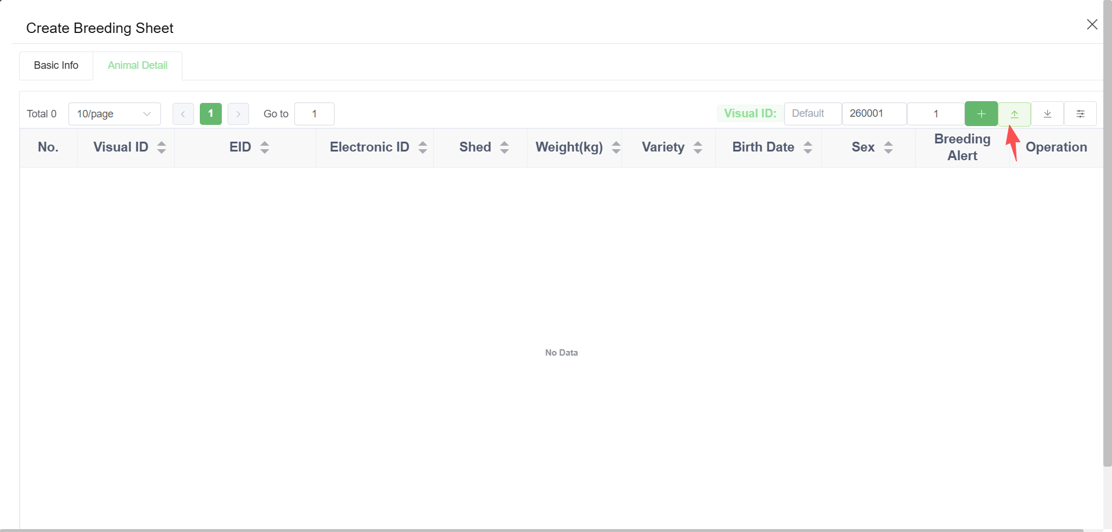
Create farming batches and enter numbers
Import the completed EXCEL file

Slide 19
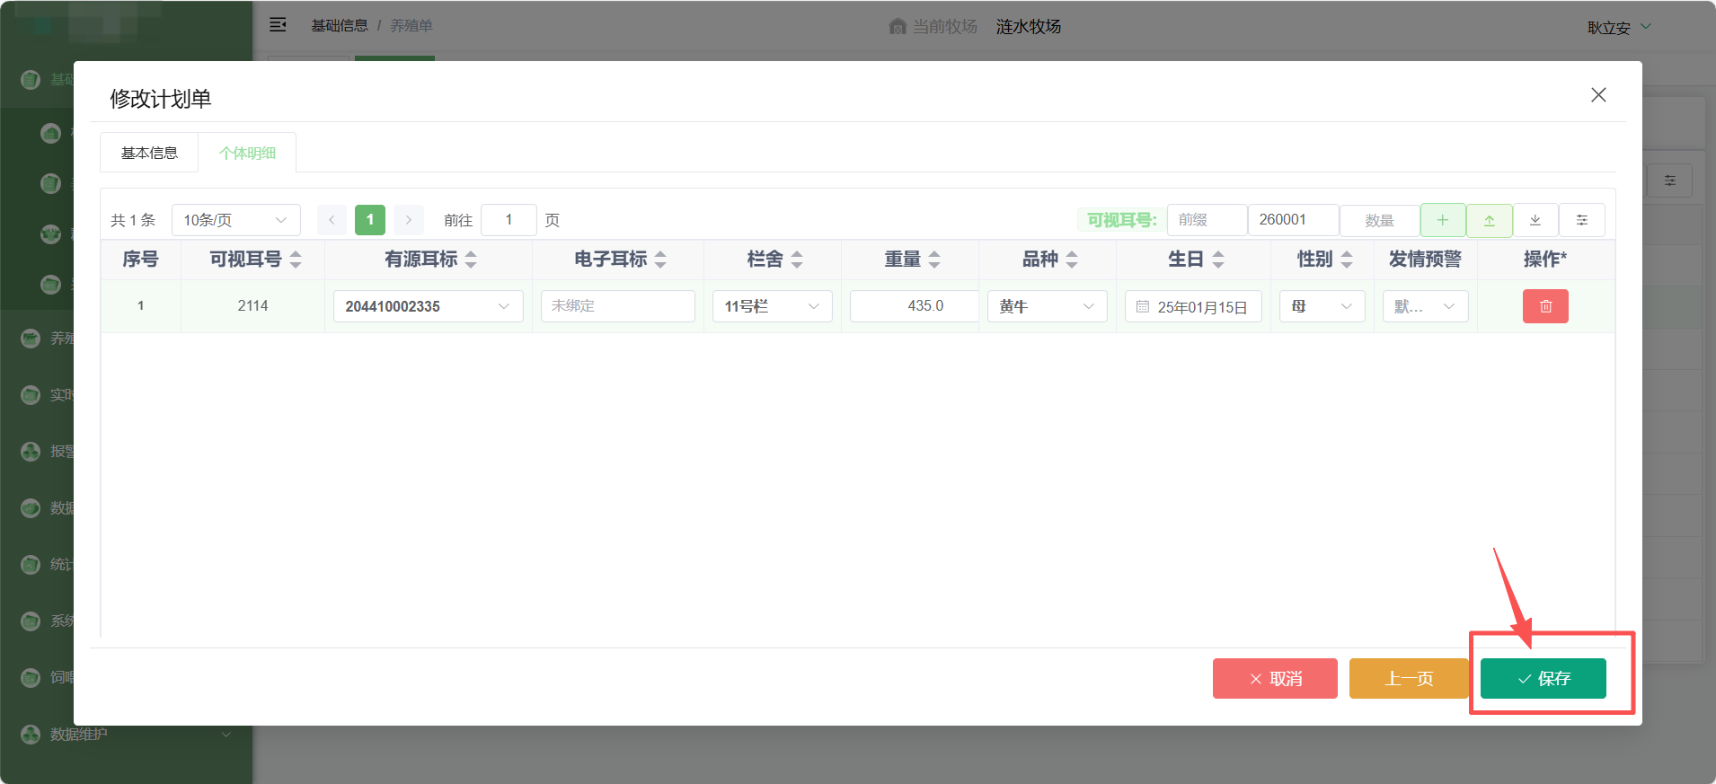
Create farming batches and enter numbers
After confirming the information is correct, click Save

Slide 20
04
Stock in

Slide 21
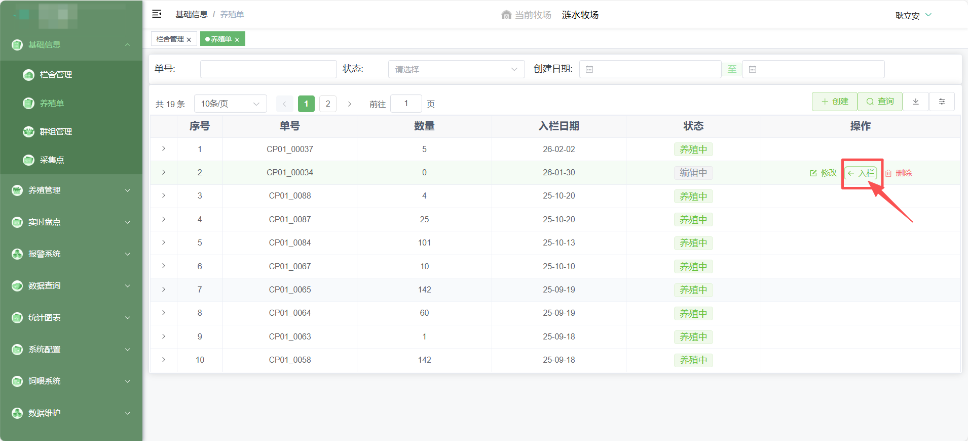
Stock in
After all animal information is entered, click Stock In to complete the operation

Slide 22
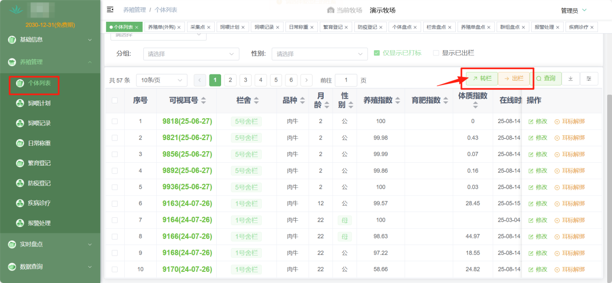
Stock in
Later, you can view livestock information in Farming Management → Individual List and perform pen transfers or stock out operations

Slide 23
05
Stock out

Slide 24
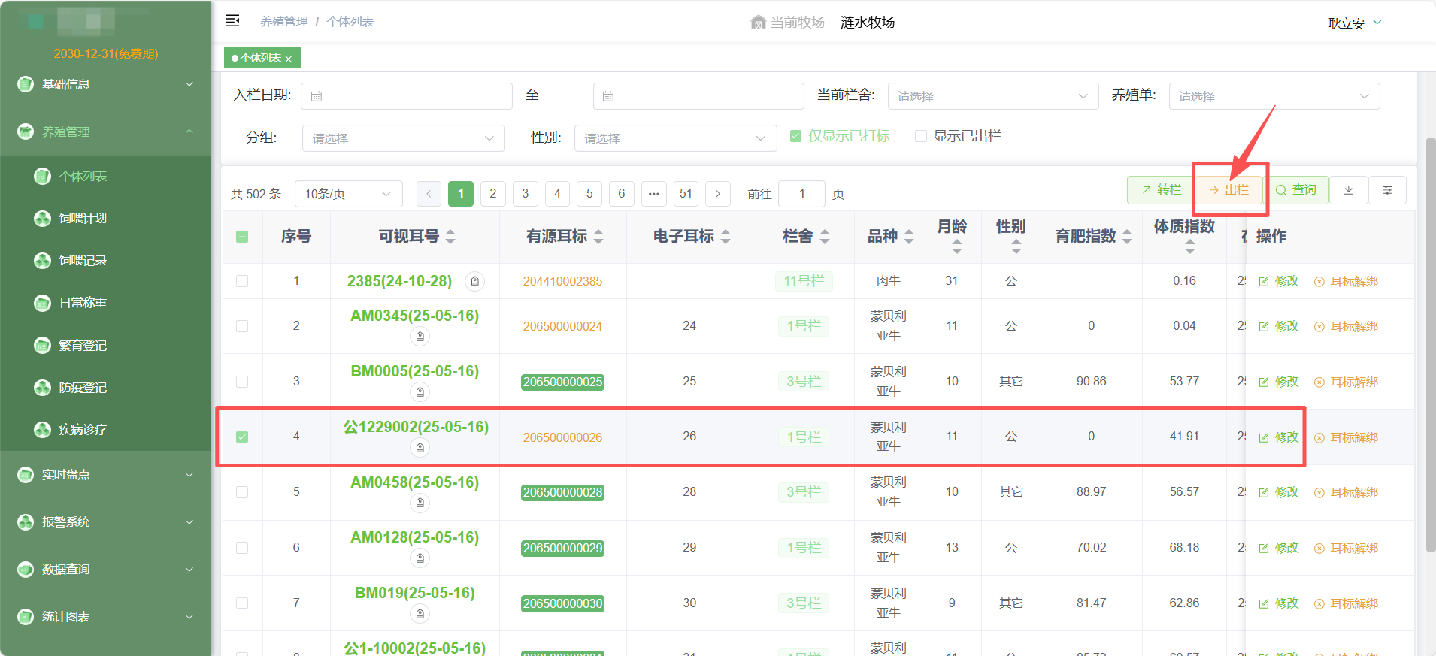
Stock out
In Farming Management → Individual List, input or select the animal number, then click the Stock Out button to remove the animal

Slide 25
06
Modify/add roles and manage permissions

Slide 26
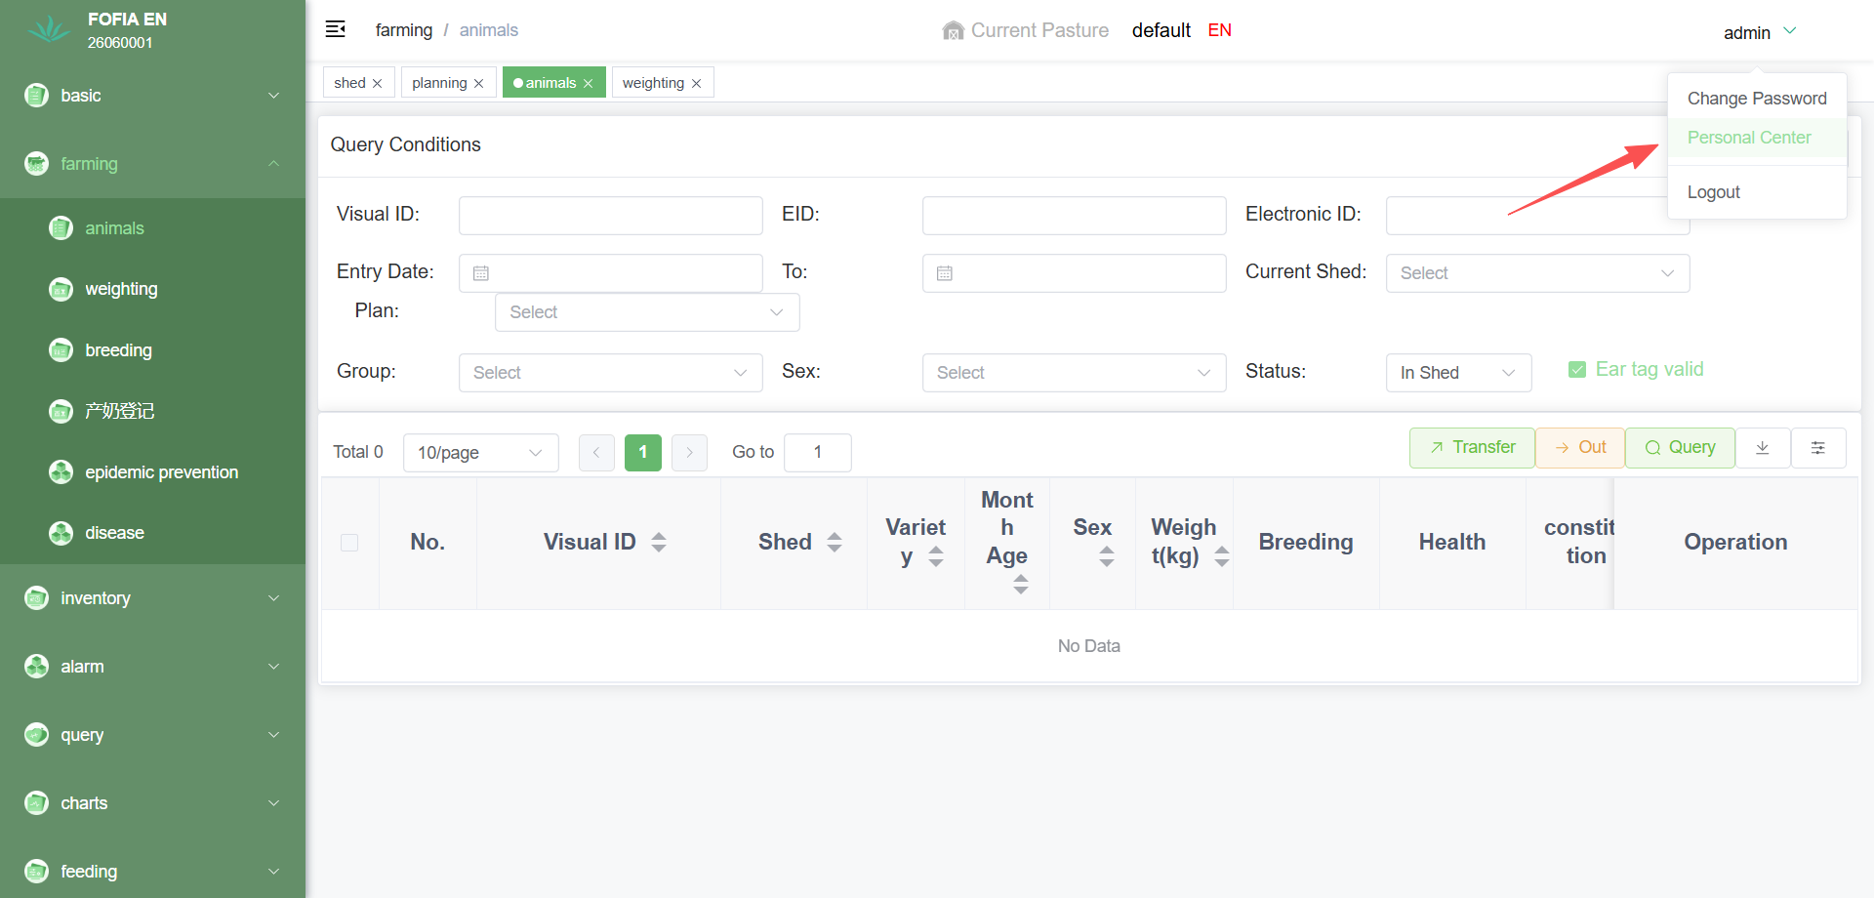
Modify/add roles and manage permissions
In the main interface of the Farming Management Platform, click the dropdown under your personal account in the top right corner, then click Personal Center

Slide 27
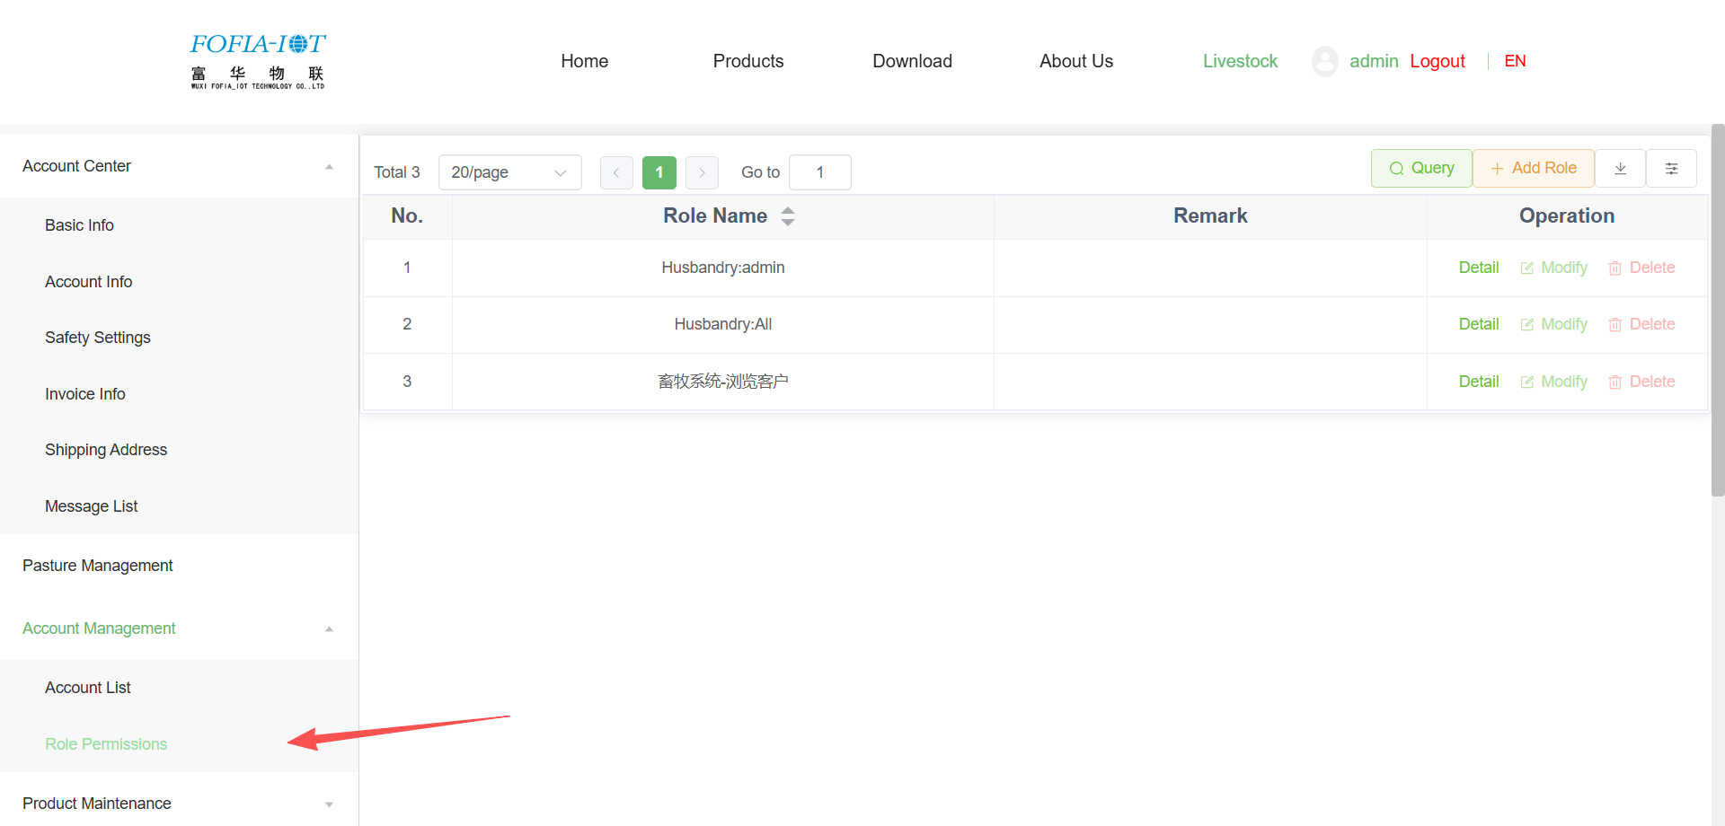
Modify/add roles and manage permissions
Click Account Management → Role Permissions on the left

Slide 28
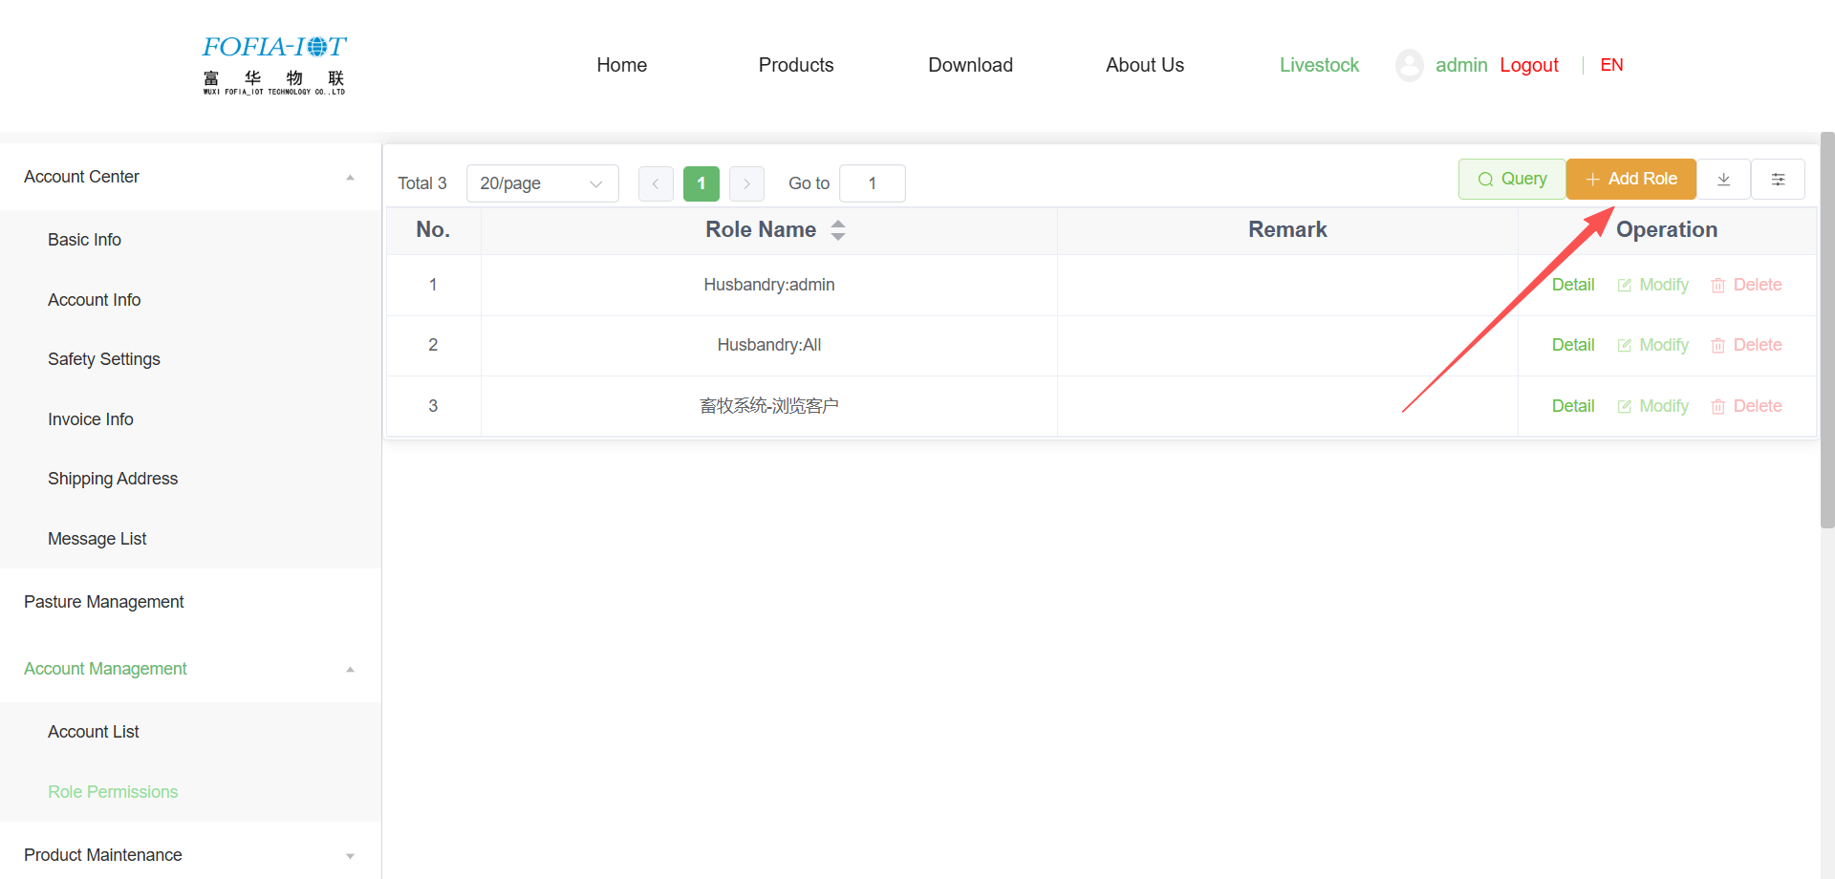
Modify/add roles and manage permissions
Click Add New

Slide 29
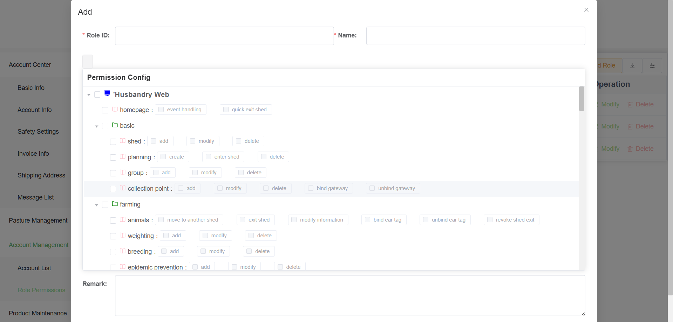
Modify/add roles and manage permissions
Check the functional modules that the role needs, then click Confirm to submit

Slide 30
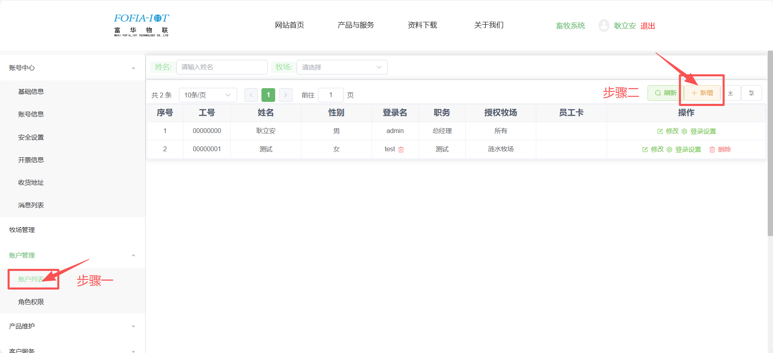
Modify/add roles and manage permissions
Click Account Management → Account List, then click Add

Slide 31
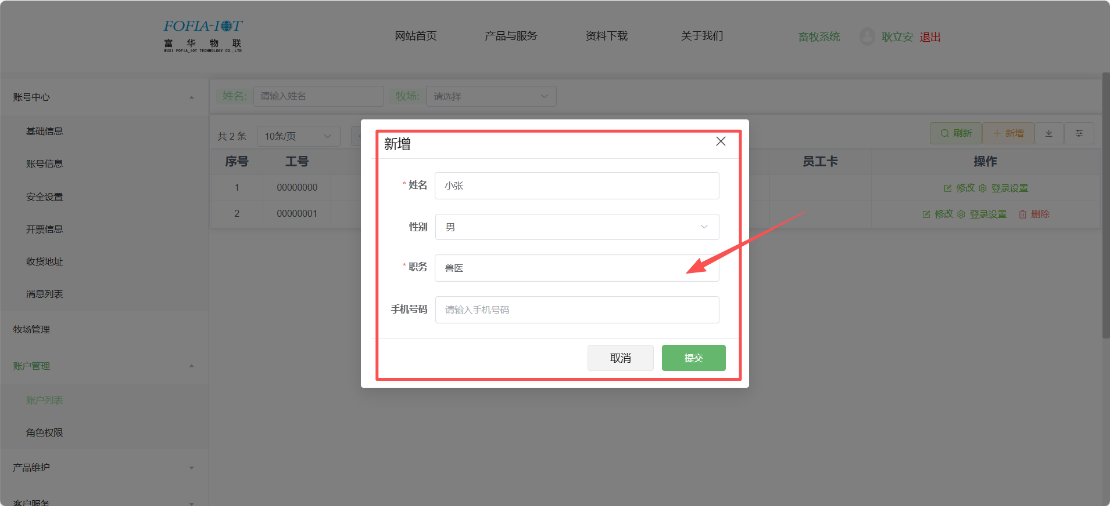
Modify/add roles and manage permissions
Fill in the personnel information

Slide 32
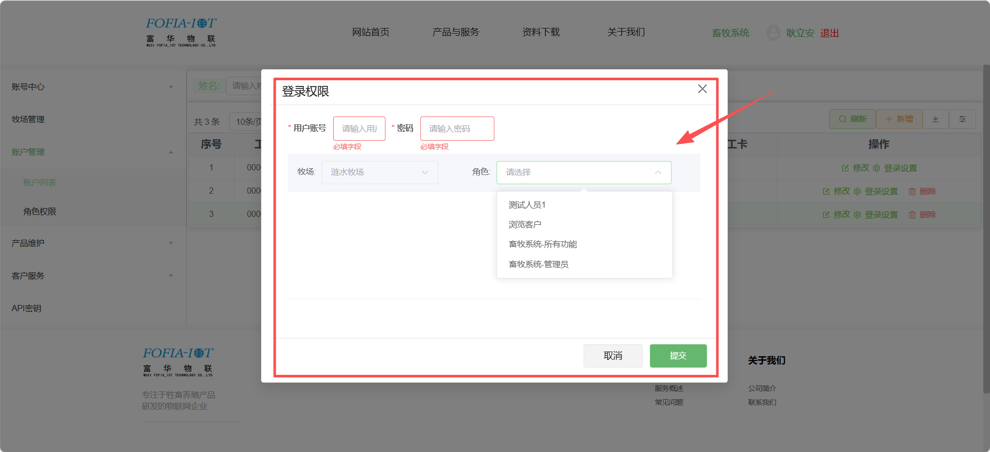
Modify/add roles and manage permissions
Enter user account, password, select the role permissions, then click Submit

